Slide 1
A Routing protocol for Distributed clustering in DTMNs
Presented by:
Ankush H Prasad
Guruguha M S
Karthik Sadanand
Under the guidance of:
Prof. D.G. Jyothi, BIT
Dr. S N Chandra Shekara , Head of Dept. CSE, SJCIT
Notes:
This template can be used as a starter file for presenting training materials in a group setting.
Sections
Right-click on a slide to add sections. Sections can help to organize your slides or facilitate collaboration between multiple authors.
Notes
Use the Notes section for delivery notes or to provide additional details for the audience. View these notes in Presentation View during your presentation.
Keep in mind the font size (important for accessibility, visibility, videotaping, and online production)
Coordinated colors
Pay particular attention to the graphs, charts, and text boxes.
Consider that attendees will print in black and white or grayscale. Run a test print to make sure your colors work when printed in pure black and white and grayscale.
Graphics, tables, and graphs
Keep it simple: If possible, use consistent, non-distracting styles and colors.
Label all graphs and tables.

Slide 2
Contents :
Overview
Introduction
Proposed System
Conclusion
Future-work
References
Notes:
What is the project about?
Define the goal of this project
Is it similar to projects in the past or is it a new effort?
Define the scope of this project
Is it an independent project or is it related to other projects?
* Note that this slide is not necessary for weekly status meetings

Slide 3
Overview :
Routing in Intermittent networks.
How clustering helps routing in DTMN.
When compared with the Direct-Delivery Routing technique, what does the observations infer?

Slide 4
Introduction :
DELAY TOLERANT NETWORK :
DTN is fundamentally an intermittent network , where the communication links only exist temporarily, rendering it impossible to establish end-to-end connections for data delivery.
The challenges of this field of research are:
1. Large delays
2. Opportunistic link availability.
3. High link-error rates that make end-to-end reliability difficult.

Slide 5



CLUSTERING :
Clustering is grouping of nodes based on a similar pattern or property like the location, priority etc.
A ROUTING PROTOCOL FOR CLUSTERING :
The routing we perform is between clusters which
involves sending information to the cluster head.

Slide 6
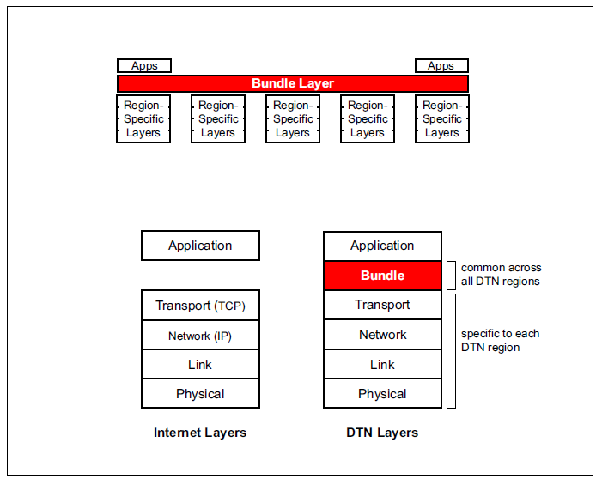
DTN Architecture :
The DTN architecture implements store-and-forward message switching by overlaying a new protocol layer, called the bundle layer—on top of heterogeneous region-specific lower layers.
The bundle layer ties together the region specific lower layers so that application programs can communicate across multiple regions.

Slide 7
Existing Routing protocols:
Some of the currently existing DTN routing protocols are Adaptive Routing for Intermittently connected mobile Ad Hoc Networks , Knowledge Based Opportunistic Forwarding, Direct Delivery Routing protocol , DHR- DTN Hierarchical Routing protocol etc.
In Direct Delivery Routing protocol, when a node needs to send a message to other node, it first finds the nearest neighbour and then sends the message to it, now this new node becomes the source node and this process continues until the destination is reached.

Slide 8
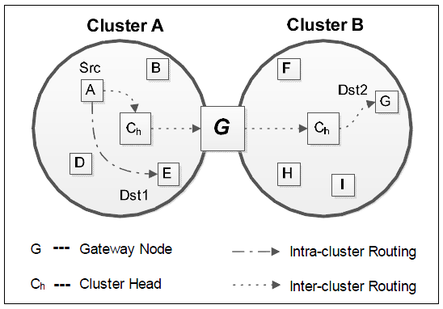
Clustering :
Proposed system :
How a cluster is formed?
How clustering in DTMN is unique ?
Cluster-based Routing :
Cluster-based Routing is of two types :
Intra-Cluster routing
Inter-Cluster routing

Slide 9
Selection of cluster-head:
If there is only one node (for theoretical purpose), by default, it becomes the cluster-head.
If there are more nodes, there are different ways of selecting cluster-head-
Calculate the centroid of the boundary of the shape, formed by the cluster.
Now, find the node that is nearest to the centroid
Assign that node as the cluster-head.
The node which is farther to the centroid, becomes the gateway.
Selection of gateway-node:

Slide 10
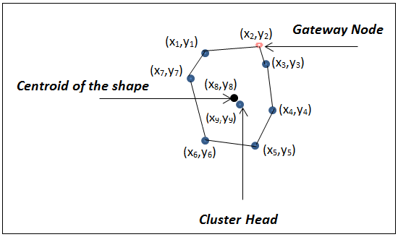
Example :

Slide 11
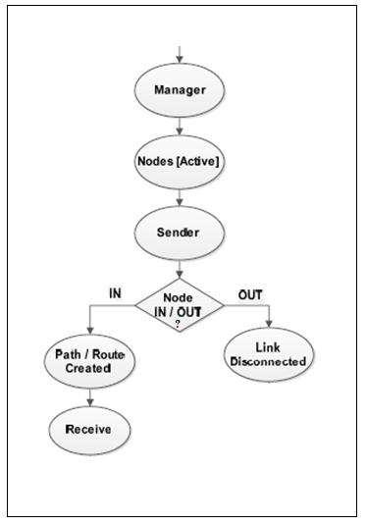
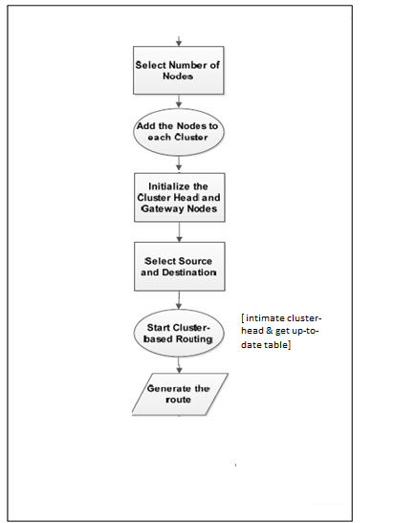
Intra-clustering overview: Inter-clustering overview :

Slide 12
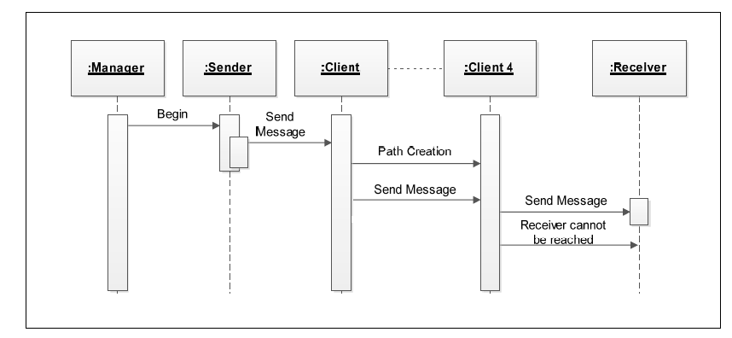
Sequence Diagram :

Slide 13
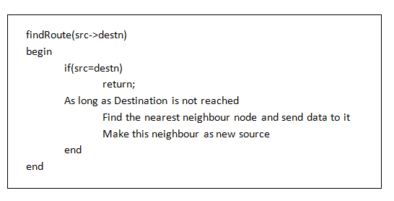
We represent the design of Inter-cluster routing as a Pseudo code as follows : (Direct Delivery Routing)

Slide 14
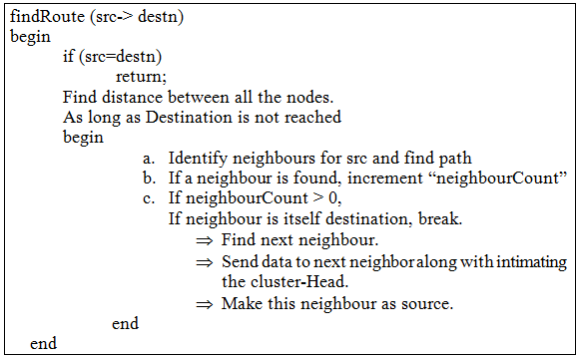
Cluster-Based Routing :

Slide 15
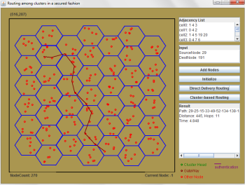
Some snapshots to give a clear idea:
On comparing Direct Delivery and the cluster based routing protocols’ time taken for a node to send the message to the destination –
Direct Delivery routing takes 4.863 => this is the time for source to send information to the destination node.

Slide 16
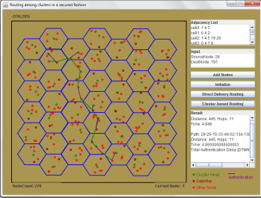
Contd.
Cluster-Based routing - 4.838000000000001 , where in the authentication delay - 3.4639999999999986 is time taken by the nodes to intimate the their cluster-heads that they are sending messages to other nodes of the cluster.

Slide 17
Conclusion :
On intermittent characteristic of the DTN.
On the role of Cluster-Head and Gateway.
Impact of the results observed.

Slide 18
Future Work :
Extension to dynamic networks to gain better conclusion.
Usage of nodal contact probability parameter.
The experiment we have performed is using Java Simulations. To induce real world scenarios, a network simulator such as ONE simulator must be used.

Slide 19
References:
Kevin Fall, “A Delay-Tolerant Network Architecture for Challenged Internets”, Intel Research, Berkeley
Jeff Wilson, “Probabilistic Routing in Delay Tolerant Networks”.
www.dtnrg.org/docs/tutorials/warthman-1.1.pdf
Evan P.C. Jones, Paul A.S. Ward, “Routing Strategies for Delay-Tolerant Networks”
“Cross-Layer Protocol Design and Optimization for Delay/Fault-tolerant Mobile Sensor Networks”, IEEE Journal on Selected Areas in Communications, Vol. 26, No. 5.
P. Krishna, N. H. Vaidya, M. Chatterjee, D. K. Pradhan, “A Cluster-based Approach for Routing in Dynamic Networks”.
Cong Liu and Jie Wu, “Scalable Routing in Delay Tolerant Networks”.
Y. Wang and Hongyi Wu. “Clustering and Cluster-based Routing Protocol for Delay-Tolerant Mobile Networks”, IEEE Transactions on Wireless Communications, Vol. 9, No. 6, June-2010.

